Slide 1
Document Object Model
Selenium Locator and its types
What you will learn Today

Slide 2
Table of Content
Introduction
Selenium Architecture and Selenium SUITE
Selenium Integration with MSTest
Selenium Basics
Document Object Model
Selenium Locators and its types

Slide 3
What is Selenium
Selenium is a robust set of tools(SUITE) that supports the rapid development of test automation for web-based, Mobile, and desktop applications.
Selenium is the most Popular Automation tool that provides a rich set of testing functions specifically geared to the needs of testing a web application.
Supports Java, C#, PHP, JavaScript, Ruby, Python, etc.

Slide 4
Selenium Components
Selenium Components
Selenium IDE
Selenium RC
Selenium 2
Selenium WebDriver
Selenium Grid
Selenium 3
Selenium 4

Slide 5
Selenium IDE
IDE (Integrated Development Environment) is the tool you use to develop your Selenium test cases.
An easy-to-use Chrome and Firefox extension and is generally the most efficient way to develop test cases.
Records the user’s actions in the browser for you, using existing Selenium commands, with parameters defined by the context of that element.
This is not only a time-saver but also an excellent way of learning Selenium script syntax

Slide 6
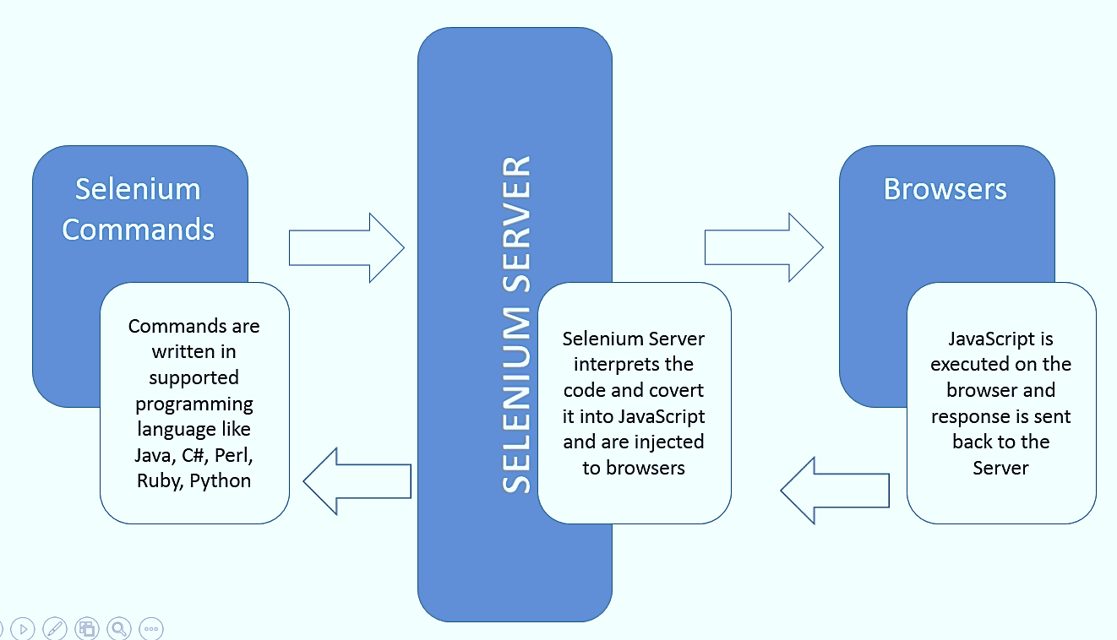
Selenium RC
Selenium RC is a server that acts as a middleman between the user and the browser that needs to interact.
RC uses Javascript, Ruby, Python, Java, C# to work with browsers while allowing the users to write code in the language of their choice.
It is also known as Selenium 1 version.
This version of Selenium is deprecated now.

Slide 7
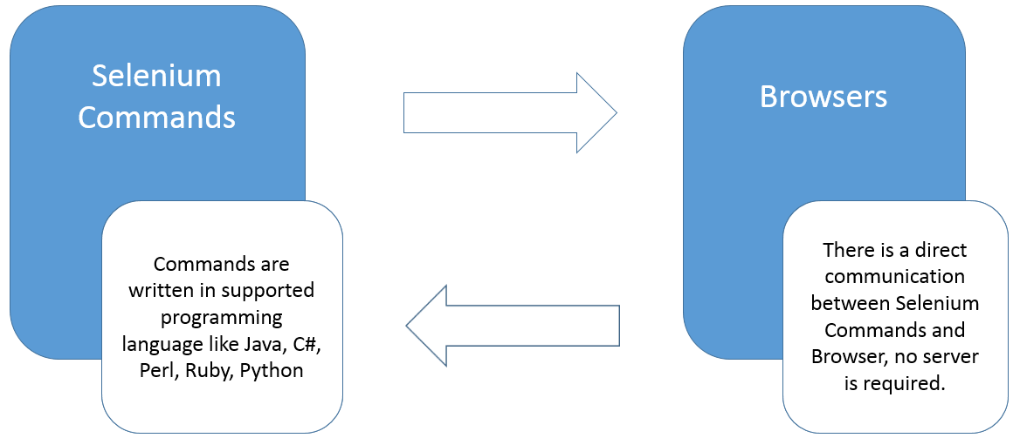
Selenium WebDriver
Selenium WebDriver is the most commonly used component of Selenium.
WebDriver allows users to write custom code in their language of choice and interact with the browser of their choice, through browser-specific drivers.
WebDriver works on the OS level and uses a Protocol called JSONWireProtocol to communicate with browsers.

Slide 8
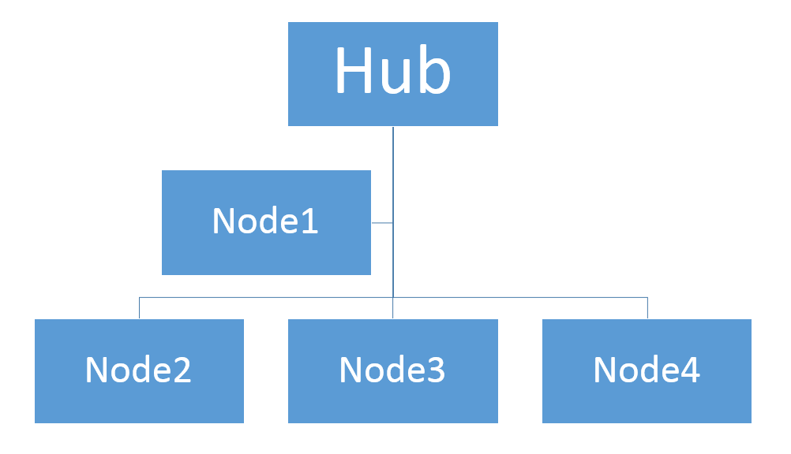
Selenium Grid
Selenium GRID allows users to run tests on different machines, with different browsers and OS simultaneously.
Gives the ability to run tests in parallel, as such saving a lot of time and resources of testing on several machines.

Slide 9
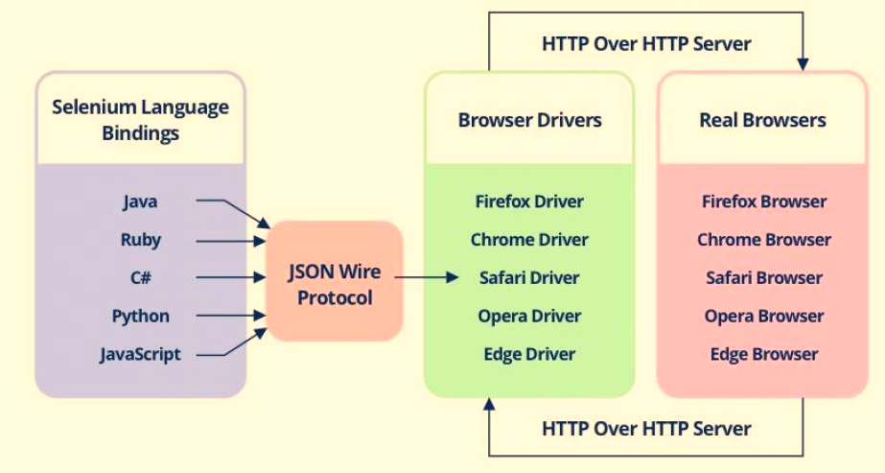
Selenium WebDriver Architecture

Slide 10
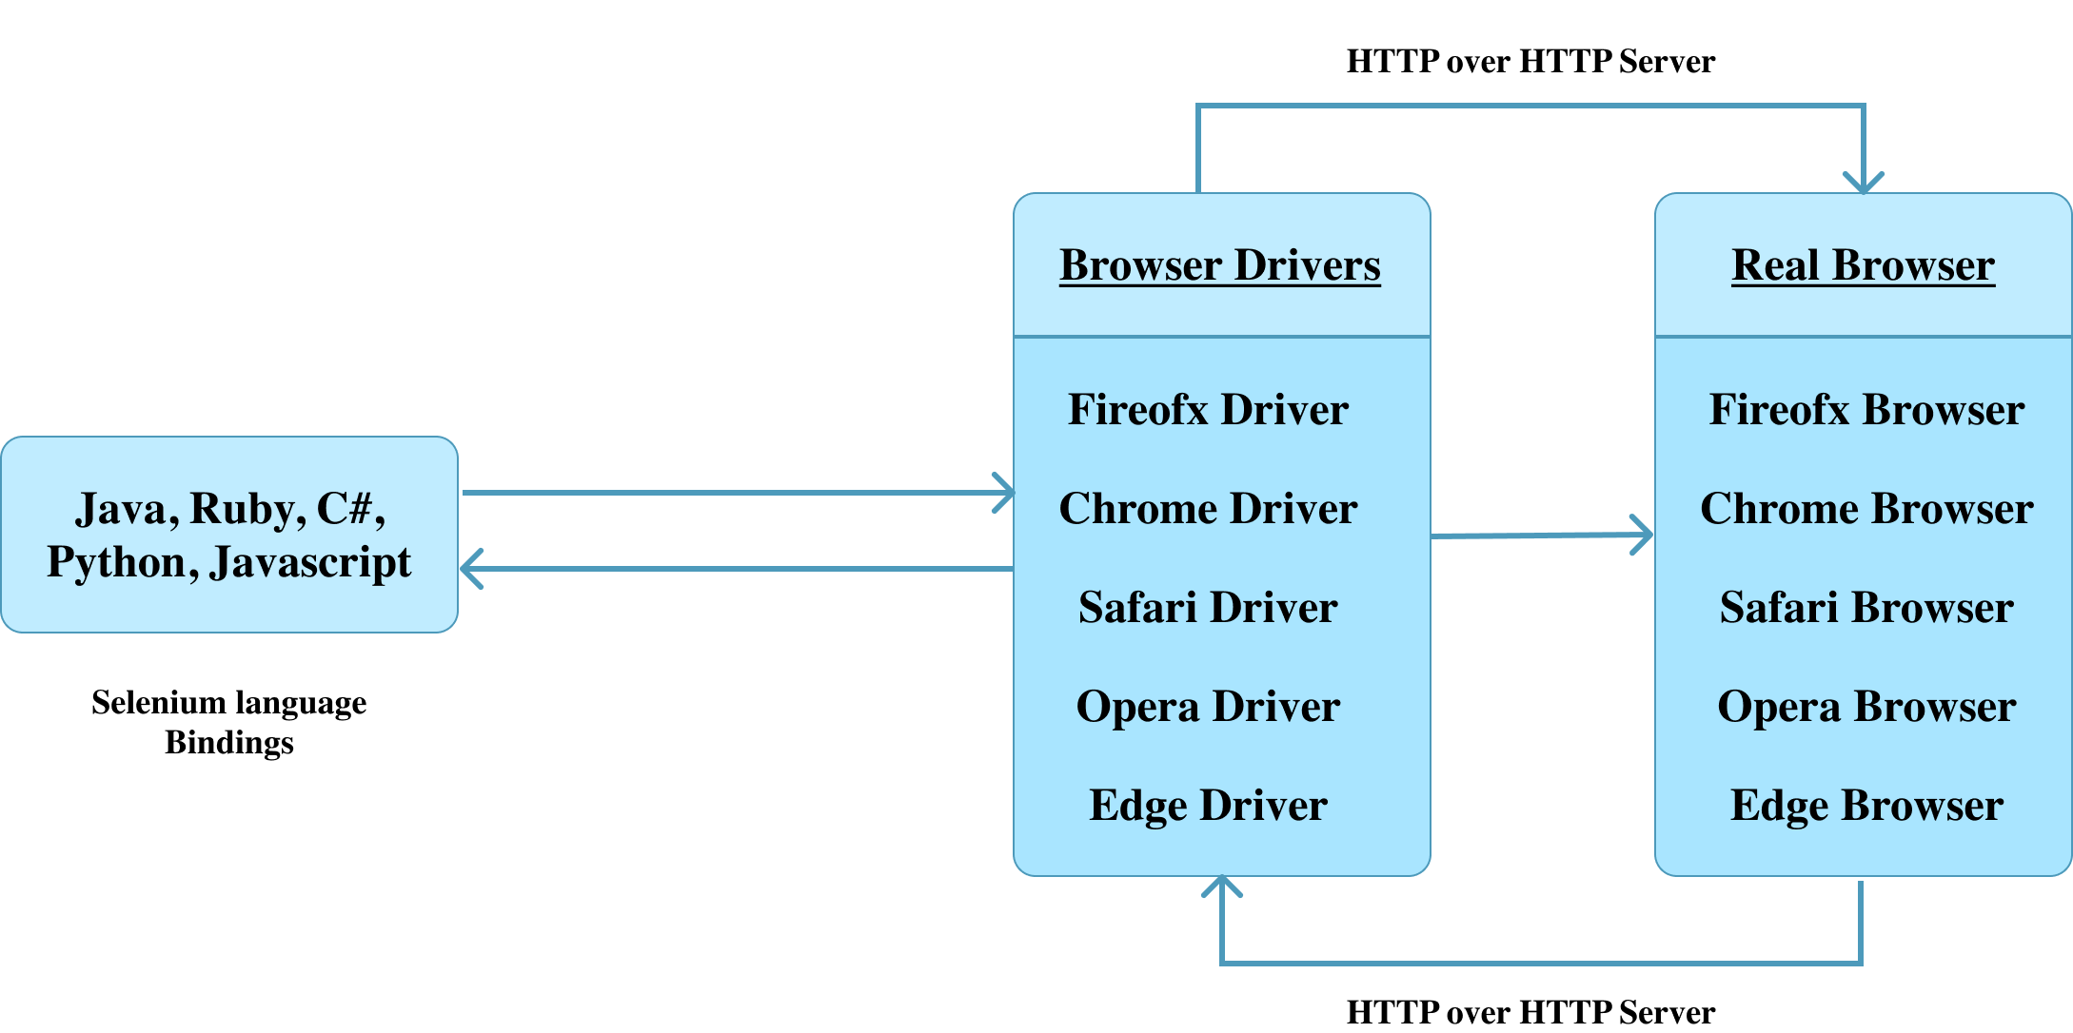
Selenium 4 Web driver Architecture

Slide 11
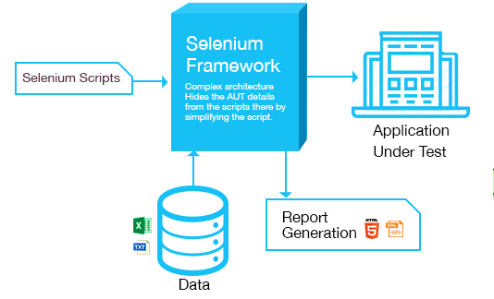
Automation Framework

Slide 12
Installation/Config SELENIUM

Slide 13
Selenium Setup
Any Visual Studio License having Unit Test Framework.
Visual Studio → New Project → Test → Unit Test Project
Assign Project/Solution Name
Need to have Driver Server Files (Chrome/Firefox/IE etc)
MSTest Adapter
Need to have the following dlls
WebDriver.dll
WebDriver.Support.dll
SCRIPTING LANGUAGE: C#

Slide 14
NuGet Package Manager
NuGet Package Manager
For installing Selenium WebDriver using the VS IDE, perform the following steps:
Navigate to Tools -> NuGet Package Manager -> Manager NuGet Packages for Solution and search for ‘Selenium.’
Install the following packages:
Selenium.WebDriver
Selenium.WebDriver.ChromeDriver
Selenium.Support

Slide 15
Document Object Model (DOM)

Slide 16

Document Object Model
The Document Object Model is a cross-platform and language-independent interface that treats an XML or HTML document as a tree structure wherein each node is an object representing a part of the document.
The DOM represents a document with a logical tree. Wikipedia

Slide 17
Automation Steps
Initialize your element / control
Locate element / control
Perform Action on element/control
Assert / Validate your action

Slide 18
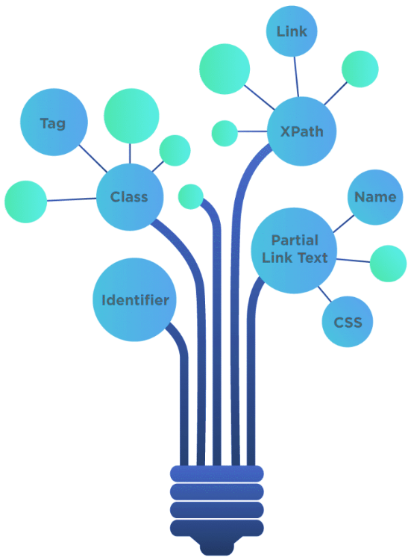
The different locators in Selenium
By ID: find_element_by_id
By Class Name: find_element_by_class_name
By Name attribute: find_element_by_name
By DOM structure or xpath: find_element_by_xpath
By link text: find_element_by_link_text
By partial link text: find_element_by_partial_link_text
By HTML tag name: find_element_by_tag_name
By CSS Selector: find_element_by_css_selectors
While all these locators return a single element, one may use the .find_elements() method to find multiple elements.

Slide 19
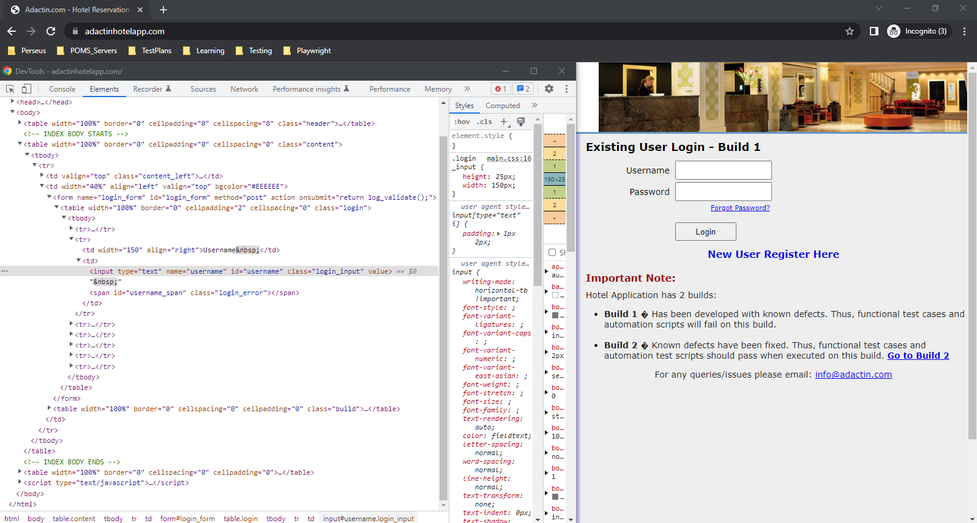
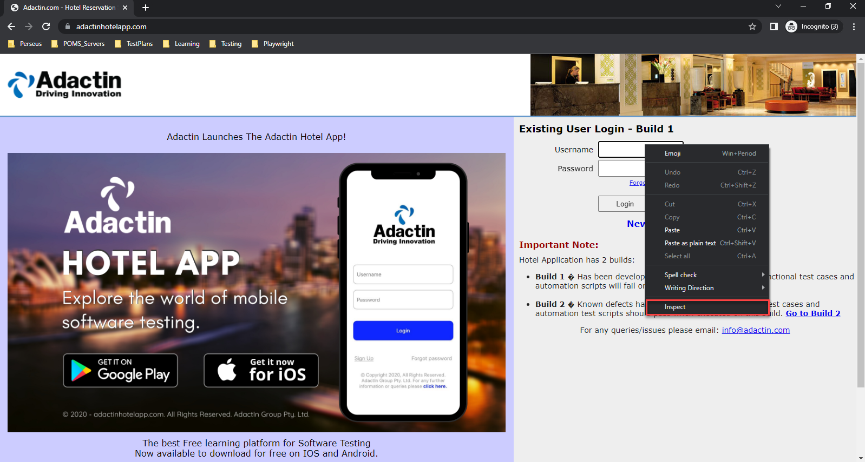
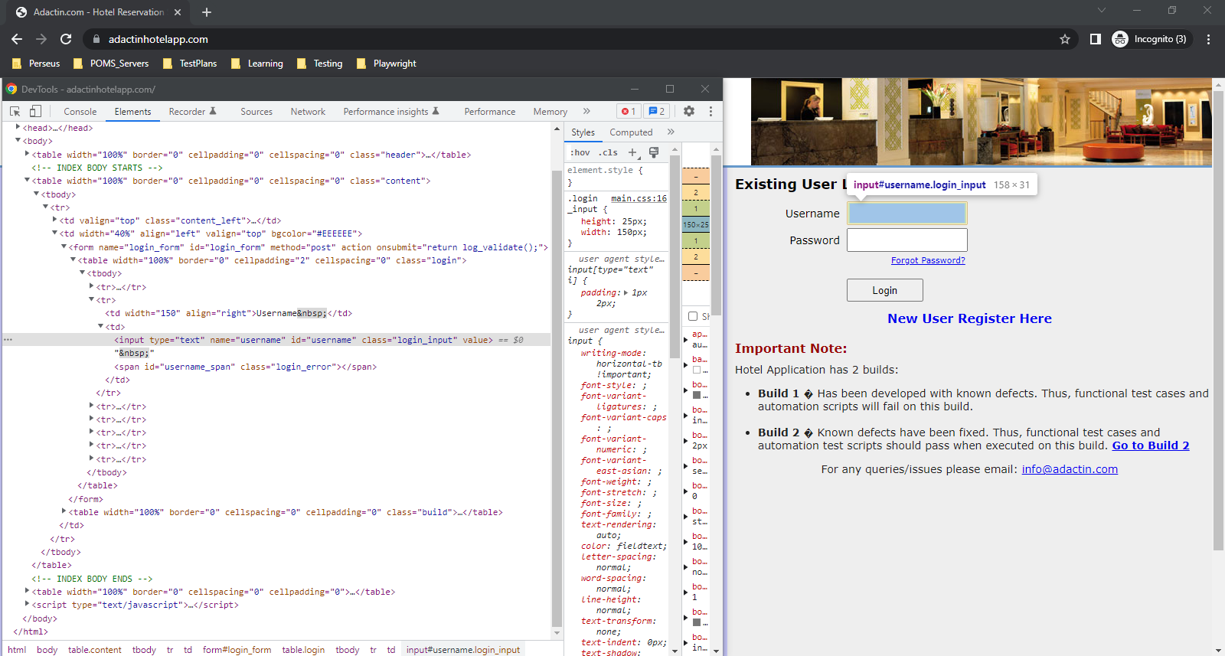
Steps to locate elements:
Right-click on the field to inspect.
It will open the Developer Tools console > Elements tab, which represents the complete DOM structure of the web page
Now, if we hover the mouse pointer over the HTML tags in the DOM, it will highlight the corresponding elements it represents on the webpage.

Slide 20
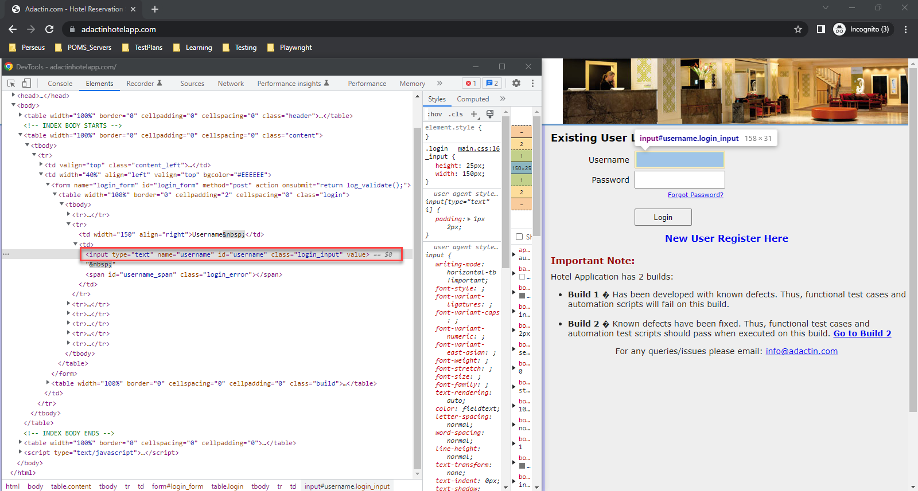
Inspect By Locators
Find element by id: By.id(“username”);
Find element by name: By.name(“username”);
Find element by class: By.ClassName(“login_input”);
Find element by id: By.id(“username”);
Find element by name: By.name(“username”);
Find element by class: By.ClassName(“login_input”);

Slide 21
ID
Selenium Locator
The ID is one of the fastest, most reliable and unique ways of locating web elements.
Syntax used:
By.Id("firstName");

Slide 22
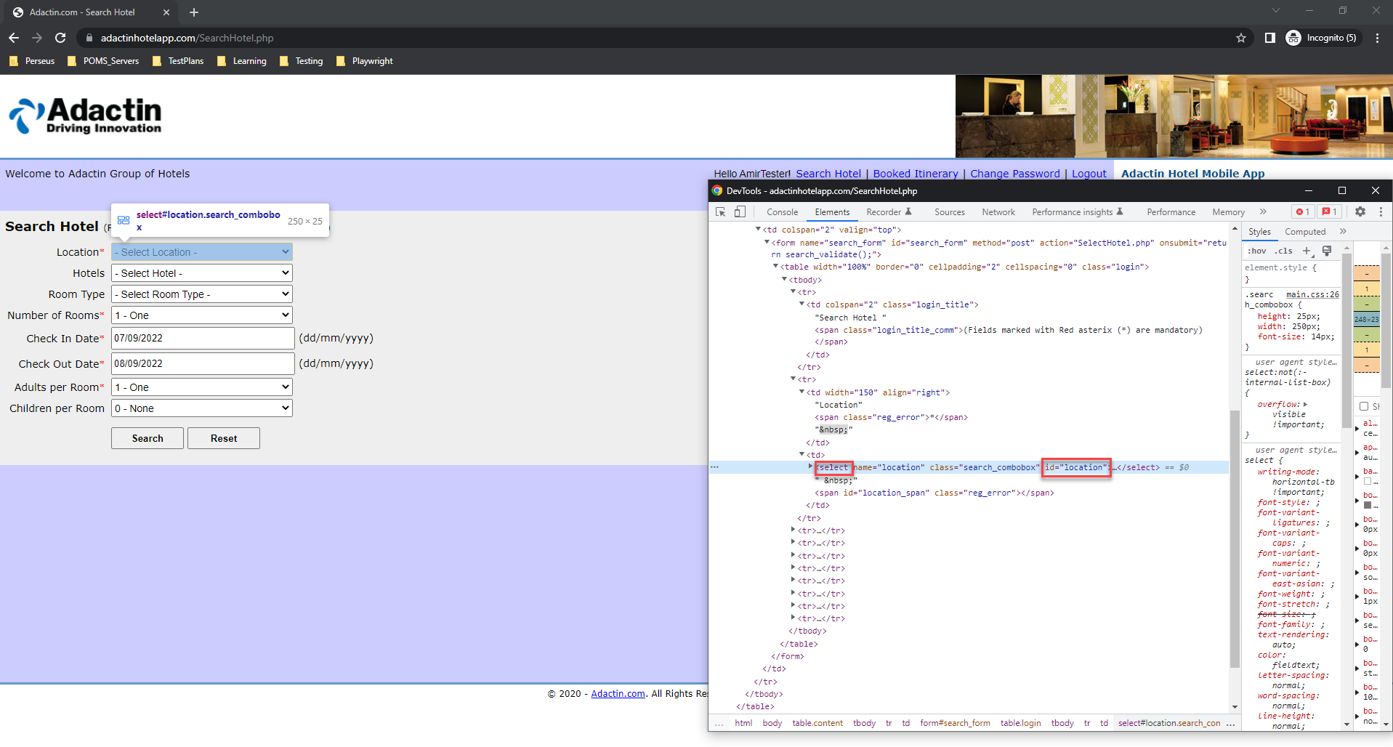
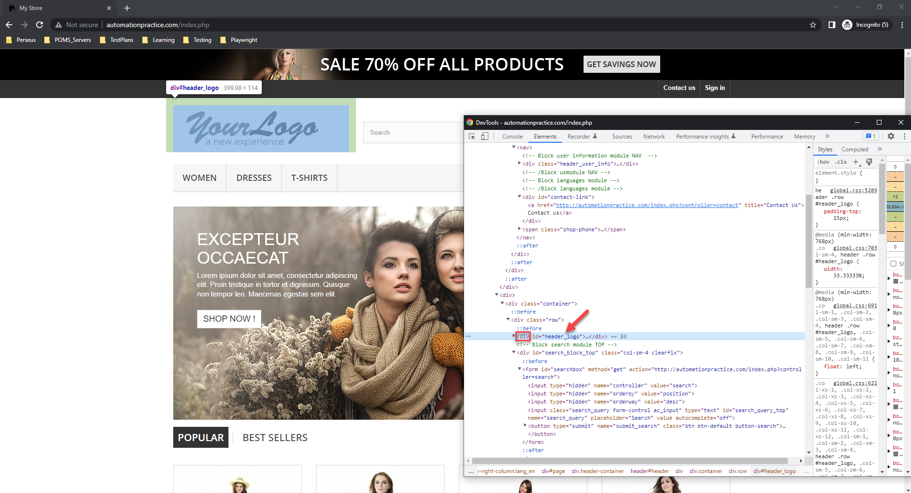
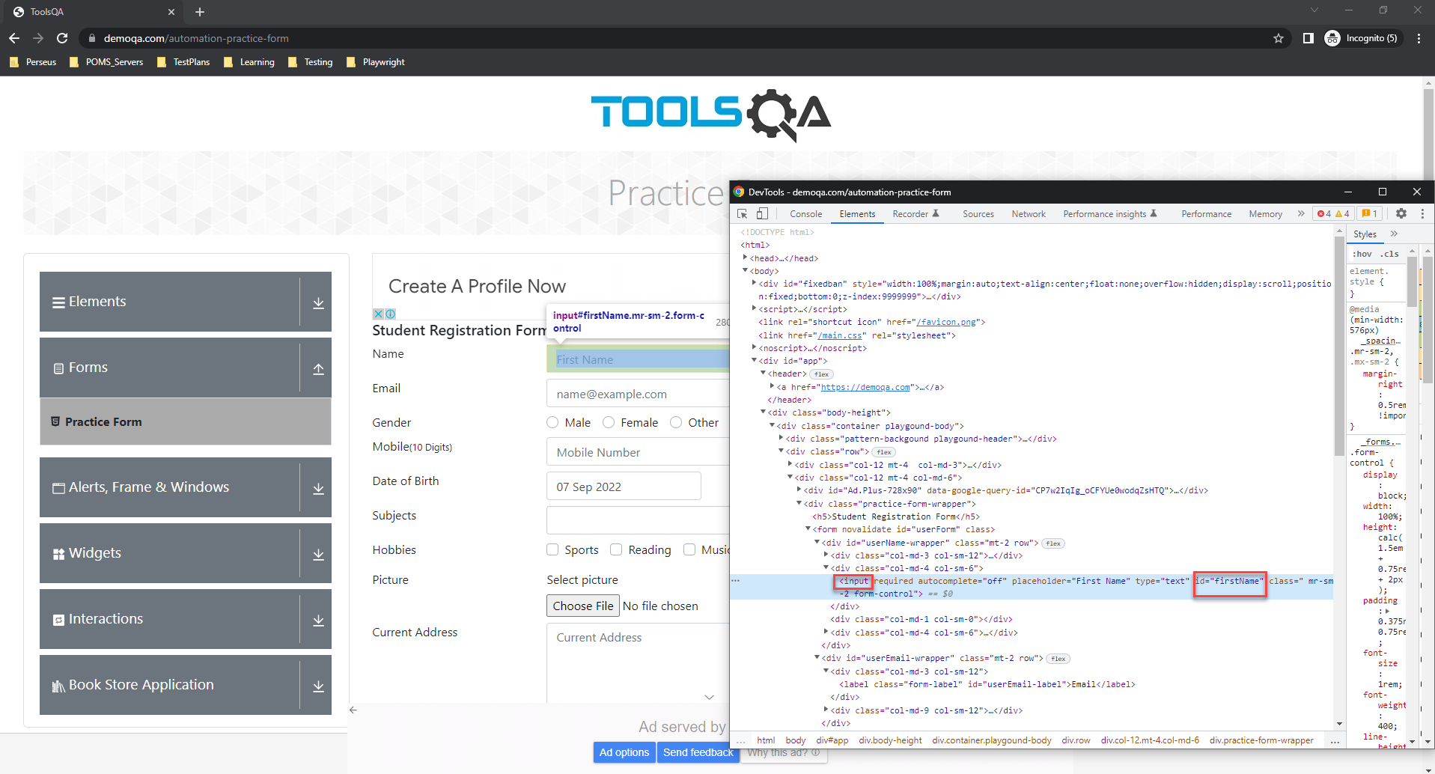

Slide 23
NAME
Selenium Locator
Selenium offers users a way to identify the element using the name attribute.
The name attribute must contain a unique value.
A web page can have multiple elements with the same “name” attribute. In this case, Selenium will select the first values on the page that match the search criteria.
Syntax used:
By.Name(“password");

Slide 24

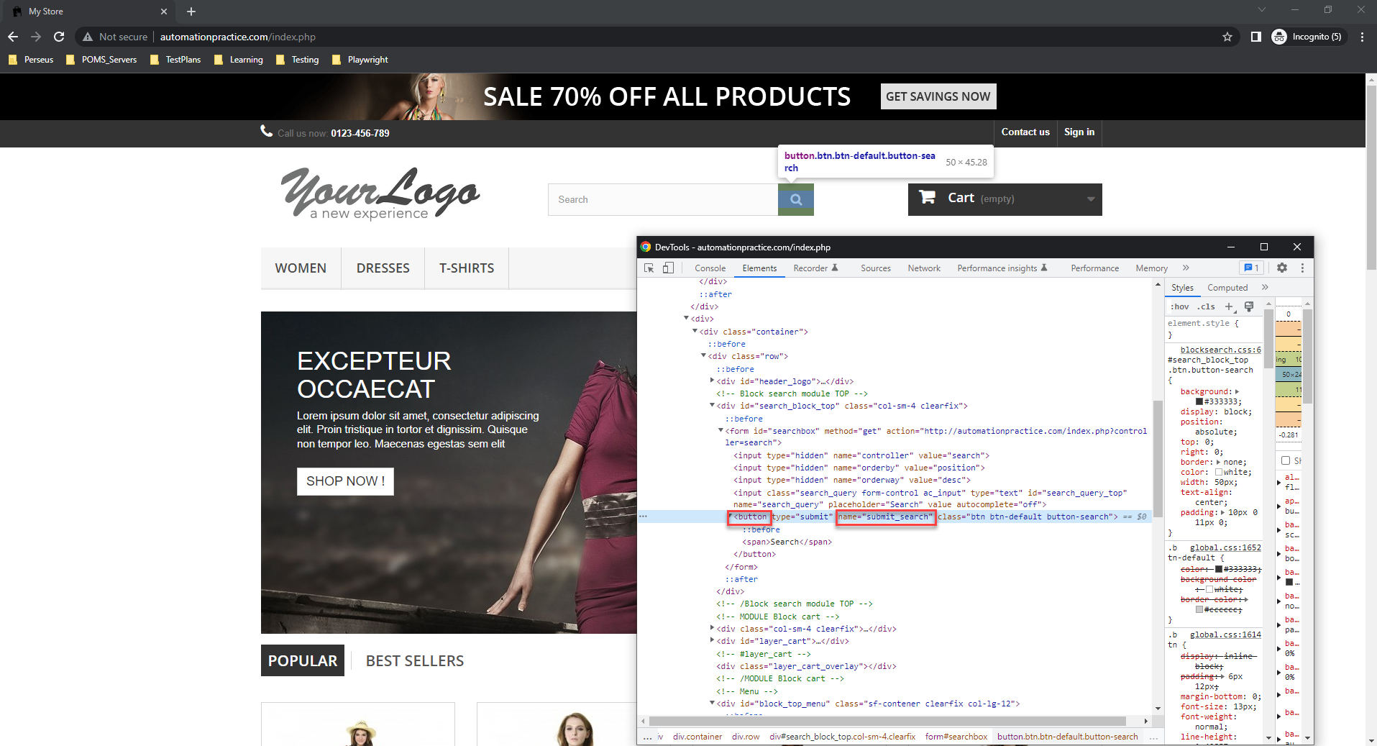
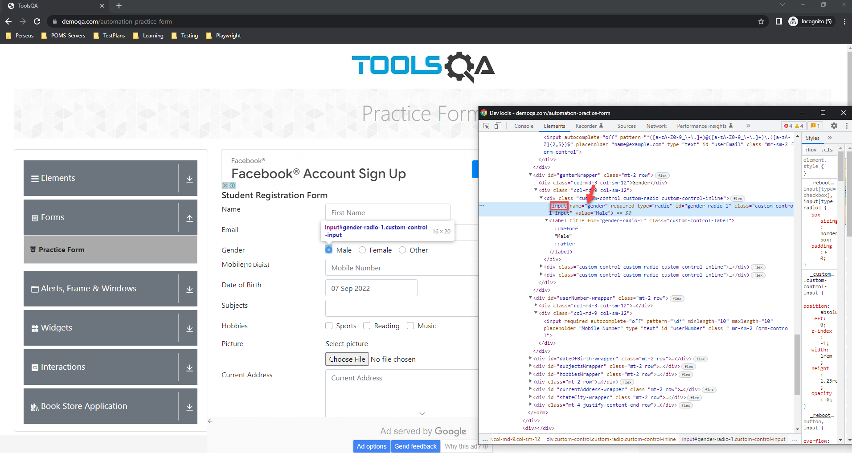

Slide 25
CLASS NAME
Selenium Locator
ClassName allows Selenium to find web elements based on the class values of the DOM.
Syntax used:
By.ClassName(“practice-form-wrapper");

Slide 26

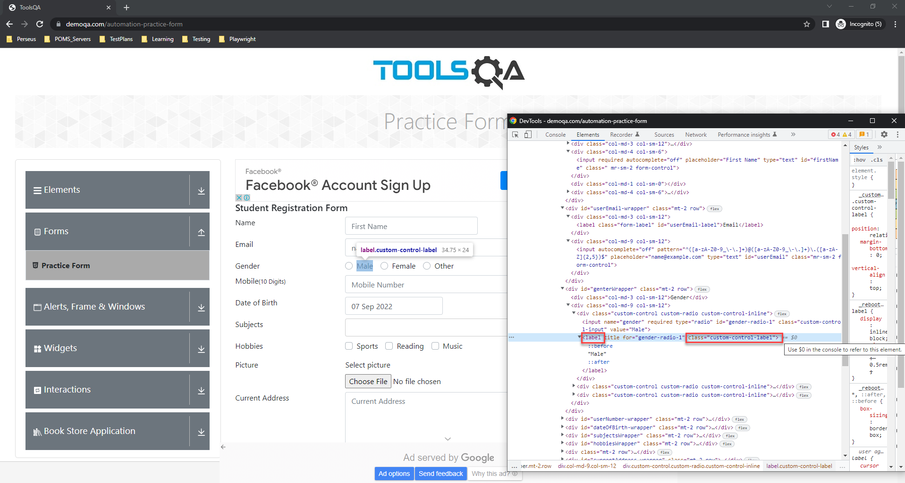
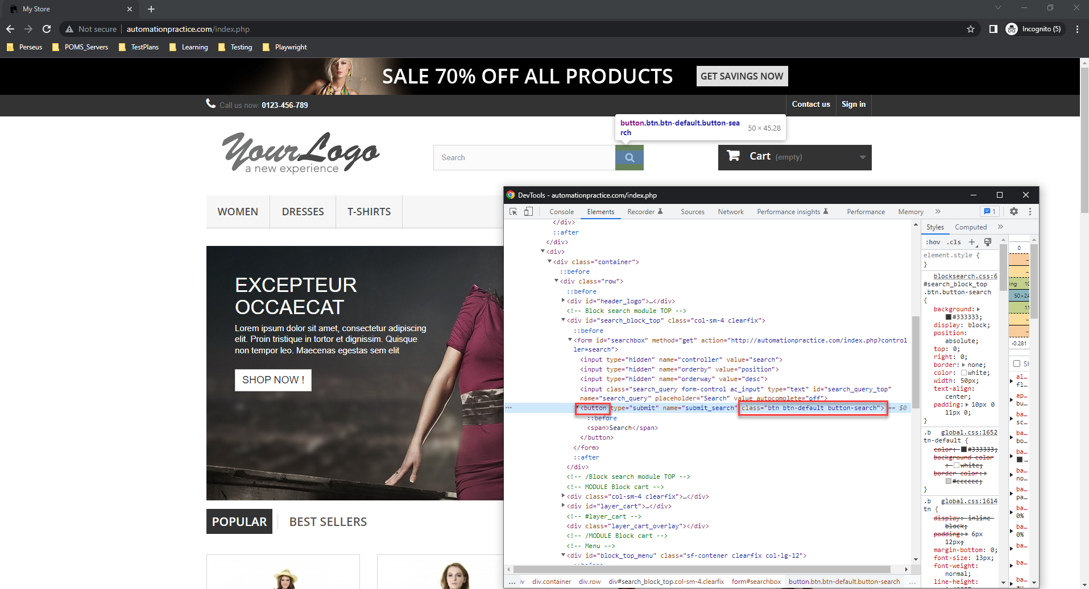

Slide 27
TAG NAME
Selenium Locator
This locator type uses tag names to identify elements in a web page.
The tag name is the HTML tag, such as ***input, div, anchor tag, button, etc.
Syntax used:
By.TagName(“a");

Slide 28

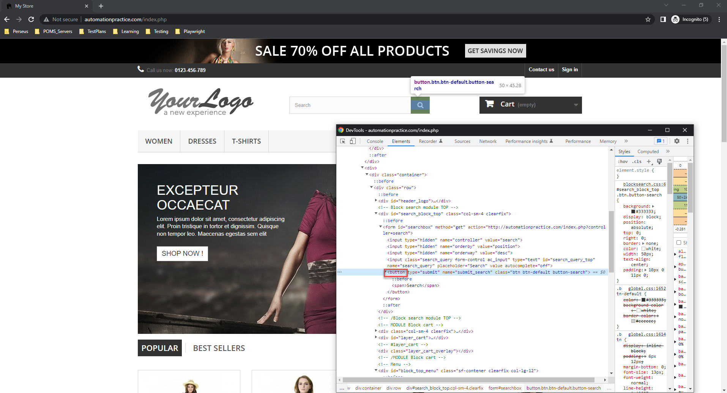
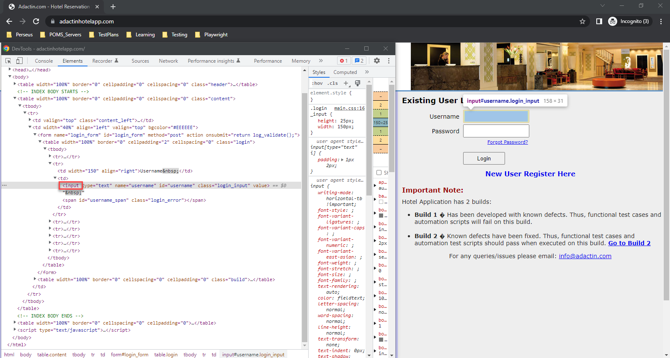

Slide 29
LINK TEXT & PARTIAL LINK TEXT
Selenium Locator
LinkText and PartialLinkText both are quite similar in functionality and locate web elements by using the hyperlink texts.
We can only use them for elements containing anchor(<a>) tags.
If multiple hyperlinks with the same texts are present on the page, then Selenium will always choose the first one. partial link text
Syntax used:
By.LinkText("Home");
By.PartialLinkText("Ho");

Slide 30
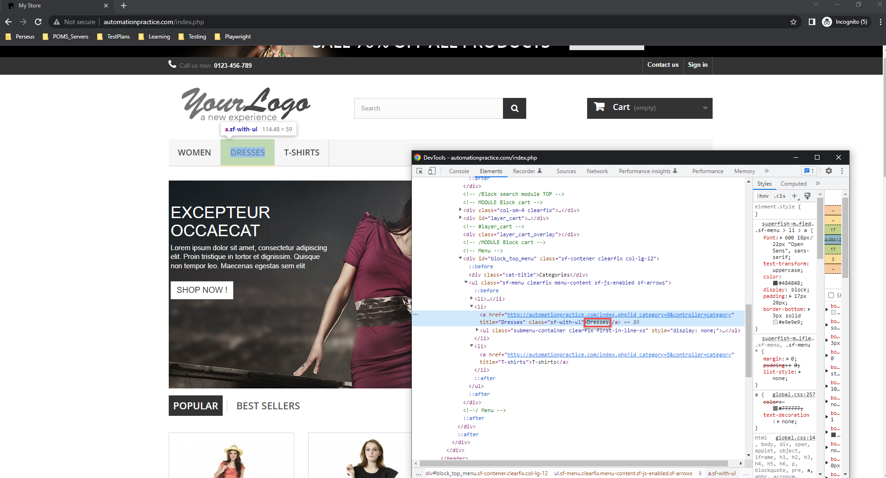
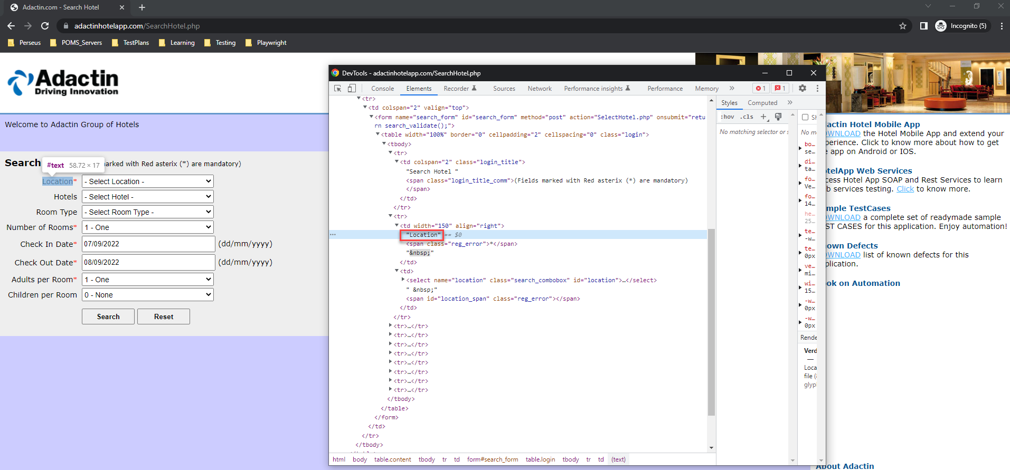
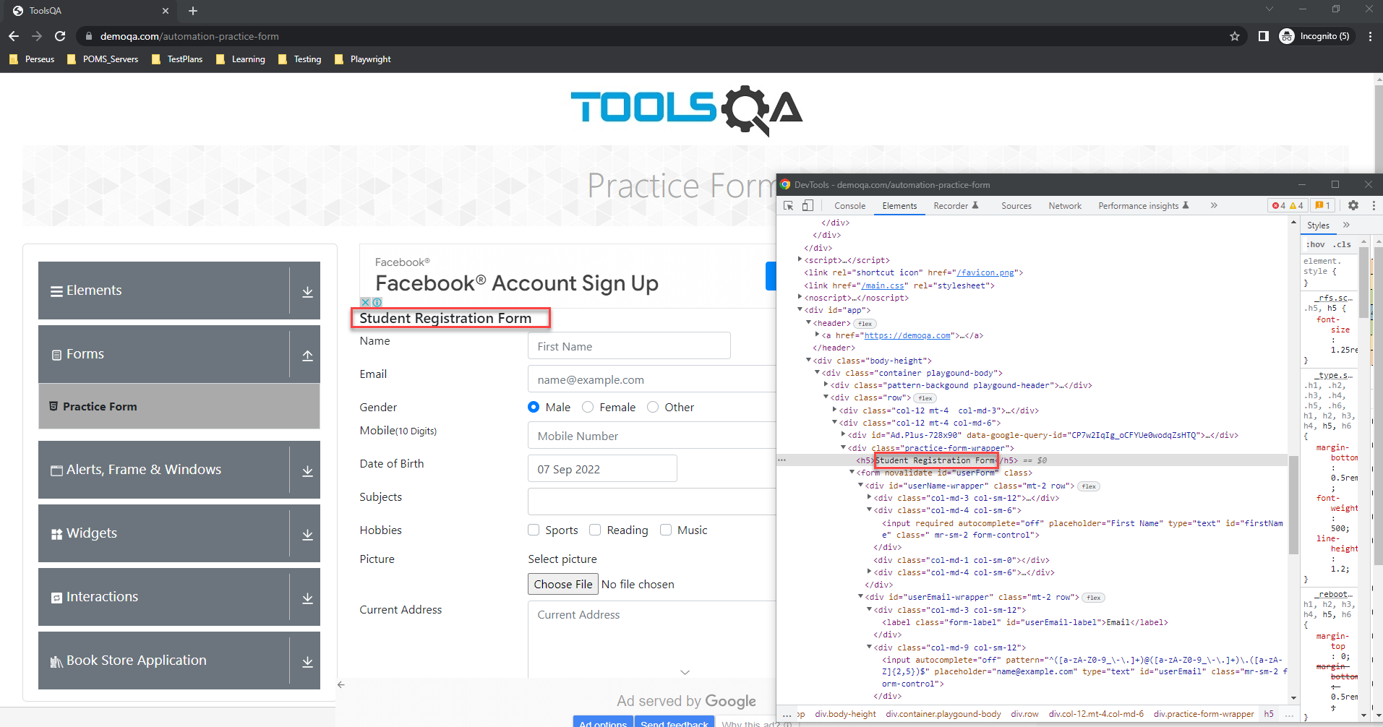

Slide 31
XPATH
Selenium Locator
XPath uses the XML expression to locate an element on the webpage.
XPath is quite useful in locating dynamic elements on a webpage.
It can access any element present in the webpage even when they have dynamic properties.
Syntax used:
By.XPath(“//tag_name[@attribute_value]”);

Slide 32
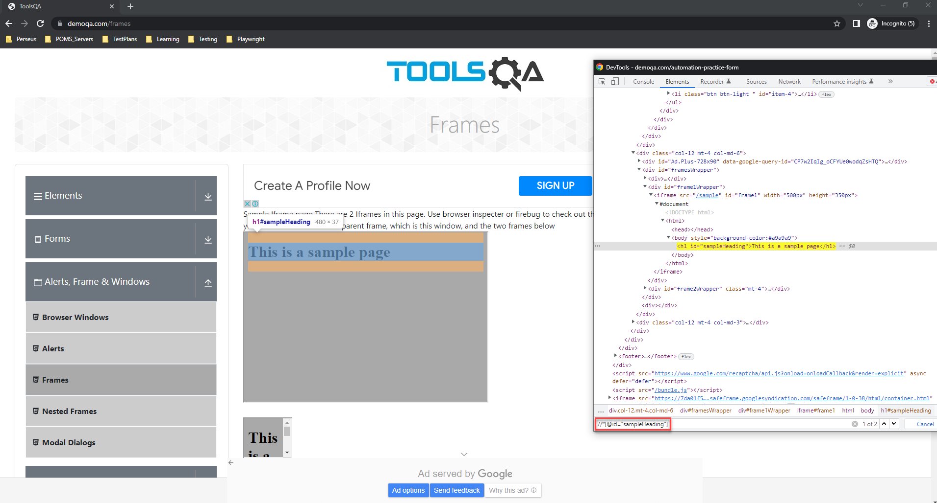
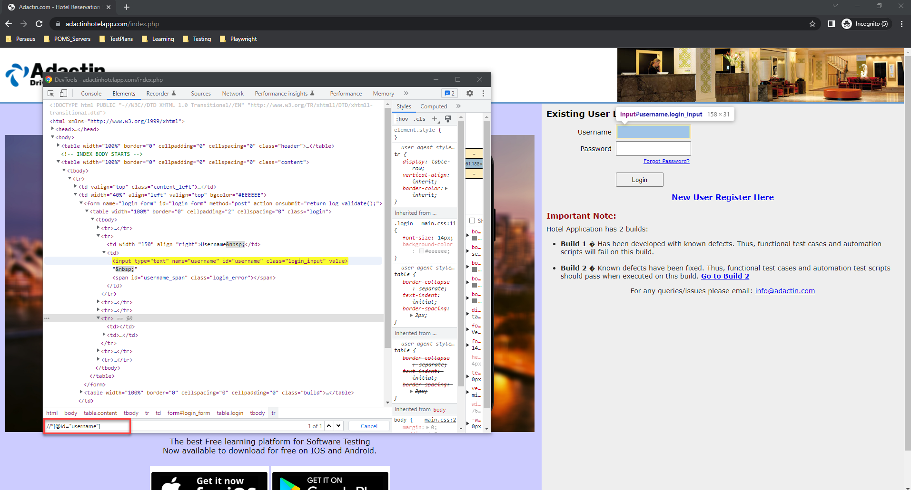
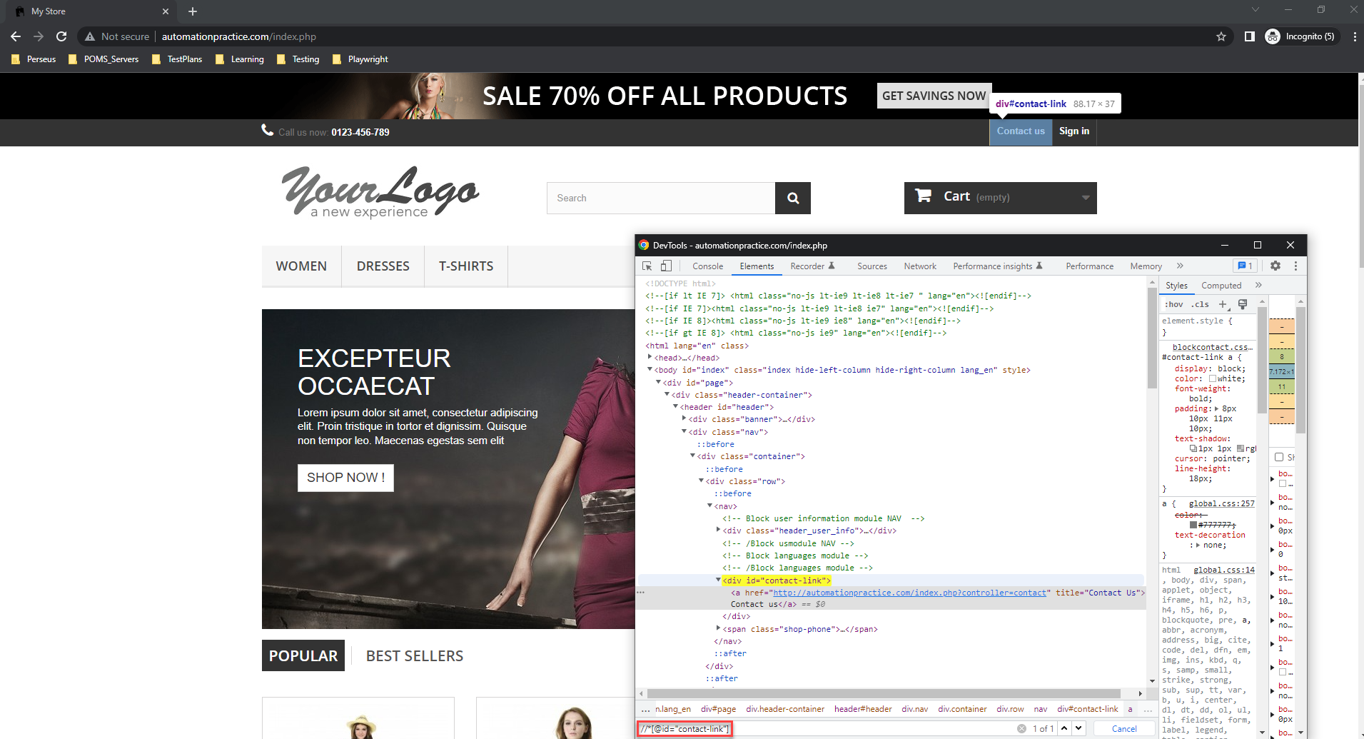

Slide 33
CSS SELECTOR
Selenium Locator
The CSS is mainly used to provide style rules for the web pages, and you can use it for identifying one or more elements in the web page.
The CSS selector is always the best possible way to locate complex elements in the page.
Syntax used:
By.CssSelector(“ [Attribute=Value]”);

Slide 35
XPath

Slide 36
Types of XPATH
XPATH
XPath can be viewed to navigate round XML documents. Thus, XPath has similarities to a set of street directions.
When you need to search for a address, you should know what is your starting point to reach your destination.
In XPath the starting point is called the context node.
Absolute XPath
Relative XPath

Slide 37
Absolute XPATH
Types of XPATH
Absolute XPath starts with the root node or a forward slash (/).
The advantage of using absolute is, it identifies the element very fast.
Disadvantage here is, if any thing goes wrong or some other tag added in between, then this path will no longer works.
Example:
If the Path we defined as html/head/body/table/tbody/tr/th
If there is a tag that has added between body and table as html/head/body/form/table/tbody/tr/th
The first path will not work as the 'form' tag added in between

Slide 38
Relative XPATH
A relative xpath is one where the path starts from the node of your choice - it doesn't need to start from the root node. It starts with Double forward slash(//)
Syntax: //table/tbody/tr/th
Other example :- .//*[@id='username’]
'.' at the start indicates that the processing will start from the current node. '*' is used for selecting all the element nodes descending from the current node with @id-attribute-value equal to 'username’.
Advantage: You can start from the middle or in between.
Disadvantage: It takes more time in identifying the element as we specify the partial path not (exact path).
If there are multiple elements for the same path, it will select the first element that is identified

Slide 39
Reading Assignment
https://www.seleniumeasy.com/selenium-tutorials/xpath-tutorial-for-selenium

Slide 40
Contextual Selectors
Contextual Selectors
Locator | Explanation
//img | image element
//img/*[1] | first child of element img
//ul/child::li | first child 'li' of 'ul'
//img[1] | first img child
//img/*[last()] | last child of element img
//img[last()] | last img child
//img[last()-1] | second last img child
//ul[*] | 'ul' that has children

Slide 41
Contextual Selectors
Attribute Selectors
Locator | Explanation
//img[@id='myId'] | image element with @id= 'myId'
//img[@id!='myId'] | image elements with @id not equal to 'myId'
//img[@name] | image elements that have name attribute
//*[contains(@id, 'Id')] | element with @id containing
//*[starts-with(@id, 'Id')] | element with @id starting with
//*[ends-with(@id, 'Id')] | element with @id ending with
//*[matches(@id, 'r')] | element with @id matching regex ‘r’
//*[@name='myName'] | image element with @name= 'myName'
//*[@id='X' or @name='X'] | element with @id X or a name X
//*[@name="N"][@value="v"] | element with @name N & specified @value ‘v’

Slide 42
Contextual Selectors
Attribute Selectors
Locator | Explanation
//*[@name="N" and @value="v"] | element with @name N & specified @value ‘v’
//*[@name="N" and not(@value="v")] | element with @name N & not specified @value ‘v’
//input[@type="submit"] | input of type submit
//a[@href="url"]​​ | anchor with target link 'url'
//section[//h1[@id='hi']] | returns <section> if it has an <h1> descendant with @id= 'hi'
//*[@id="TestTable"]//tr[3]//td[2] | cell by row and column
//input[@checked] | checkbox (or radio button) that is checked
//a[@disabled] | all 'a' elements that are disabled
//a[@price > 2.50] | 'a' with price > 2.5

Slide 43
XPath Methods
Locator | Explanation
//table[count(tr) > 1] | return table with more than 1 row
//*[.="t"] | element containing text 't' exactly
//a[contains(text(), "Log Out")] | anchor with inner text containing 'Log Out'
//a[not(contains(text(), "Log Out"))] | anchor with inner text not containing 'Log Out'
//a[not(@disabled)] | all 'a' elements that are not disabled

Slide 44
Contextual Selectors
Axis Navigation
Locator | Explanation
//td[preceding-sibling::td="t"] | cell immediately following cell containing 't' exactly
//td[preceding-sibling::td[contains(.,"t")]] | cell immediately following cell containing 't'
//input/following-sibling::a | 'a' following some sibling 'input'
//a/following-sibling::* | sibling element immediately following 'a'
//input/preceding-sibling::a | 'a' preceding some sibling 'input'
//input/preceding-sibling::*[1] | sibling element immediately preceding 'input'
//img[@id='MyId']::parent/* | the parent of image with id

Slide 45
Math methods
Locator | Explanation
ceiling(number) | evaluates a decimal number and returns the smallest integer greater than or equal to the decimal number
floor(number) | evaluates a decimal number and returns the largest integer less than or equal to the decimal number
round(decimal) | returns a number that is the nearest integer to the given number
sum(node-set) | returns a number that is the sum of the numeric values of each node in a given node-set
ceiling(number) | evaluates a decimal number and returns the smallest integer greater than or equal to the decimal number

Slide 46
Contextual Selectors
String Methods
Locator | Explanation
contains(space-string, planet-string) | determines whether the first argument string contains the second argument string and returns boolean true or false
concat(string1, string2 [stringn]*) | concatenates two or more strings and returns the resulting string
normalize-space(string) | strips leading and trailing white-space from a string, replaces sequences of whitespace characters by a single space, and returns the resulting string
starts-with(spacetrack, space) | checks whether the first string starts with the second string and returns true or false
string-length([string]) | returns a number equal to the number of characters in a given string
substring(string, start [length]) | returns a part of a given string
substring-after(spacetrack, track) | returns a string that is the rest of a given string after a given substring
substring-before(spacetrack, tra) | returns a string that is the rest of a given string before a given substring
translate(string, ghj, GHJ) | evaluates a string and a set of characters to translate and returns the translated string

Slide 47
CSS Selectors

Slide 48
CSS Selector
When we don't have an option to choose Id or Name, we should prefer using CSS locators as the best alternative.
CSS is "Cascading Style Sheets" and it is defined to display HTML in structured and colorful styles applied to the webpage.
Selectors are patterns that match against elements in a tree and as such form one of several technologies that can be used to select nodes in an XML document.
CSS has more Advantages than XPath and is much faster and simpler than XPath.
Syntax:
tagName[attributename=attributeValue]
Example 1: input[id=email]
Example 2: input[name=email][type=text]

Slide 49
CSS Selector
In CSS there are two special characters that have important roles to play.
dot(.) refers to a class
Hash(#) refers to Id
Using CSS locators, we can also locate elements with sub-strings. Which are really helpful when there are dynamically generated ids in the webpage
There are there important special characters in CSS selectors:
'^' symbol, represents the starting text in a string.
'$' symbol represents the ending text in a string.
'*' symbol represents contains text in a string.
css=input.submitbtn
css=input#submitbtn

Slide 50
Reading Assignment
https://www.seleniumeasy.com/selenium-tutorials/css-selectors-tutorial-for-selenium-with-examples

Slide 51
Contextual Selectors
Element Selectors
Locator | Explanation
l#myId | <ul> element with @id= 'myId'
#myUniqueId | any element with @id='myId'
ul.myForm | <ul> element with @class = 'myForm'
.myForm.front | any element with @classes = 'myfor' and 'front'

Slide 52
Contextual Selectors
Locator | Explanation
ul#myUniqueId > li | direct child element
ul#myUniqueId li | sub child element
div > p - all <p> | elements that are a direct descendant of a <div> element
div + p - all <p> | elements that are the next sibling of a <div> element (i.e. placed directly after)
div ~p - all <p> | elements that follow, and are siblings of <div> elements
form myForm.front + ul | next sibling
div.row * | selects all elements that are descendant (or child) of the elements with div tag and 'row' class

Slide 53
Pseudo-class Selectors for siblings
Locator | Explanation
ul#myUniqueId li:first-child | ​first child element
​ul#myUniqueId li:nth-of-type(1) | ​first child element
​ul#myUniqueId li:last-child | ​last child element
​ul#myUniqueId li:nth-of-type(3) | ​last child element
​#TestTable tr:nth-child(3) td:nth-child(2) | ​cell by row and column (e.g. 3rd row, 2nd column)
​p::first-letter | ​selects the first letter of the specified 'p'
​p::first-line | ​selects the first line of the specified 'p'
​p:first-of-type | ​selects any <p> that is the first element of its type among its siblings
​p:last-of-type | ​selects any <p> that is the last element of its type among its siblings

Slide 54
Pseudo-class Selectors for Link & User State
Locator | Explanation
a:visited | ​all visited links
​a:link | ​all unvisited links
​a:hover | ​all links on mouse hover
​input:active | ​every active <input> element
​input:disabled | ​every disabled <input> element
​input:enabled | ​every enabled <input> element
​input:focus | ​the <input> element which has focus
​input:read-only | ​<input> elements with the 'readonly' attribute specified
​input:required | ​<input> elements with the ​'required' attribute specified
​input:checked | ​checkbox (or radio button) that is checked
​a:contains('Log Out') | ​anchor with inner text containing 'Log Out'

